Slide 1
Agile Development

Slide 2
Common Fears for Developers
The project will produce the wrong product.
The project will produce a product of inferior quality.
The project will be late.
We’ll have to work 80-hour weeks.
We’ll have to break commitments.
We won’t be having fun.

Slide 3
The Manifesto for Agile Software Development
“We are uncovering better ways of developing software by doing it and helping others do it. Through this work we have come to value:
Individuals and interactions over processes and tools
Working software over comprehensive documentation
Customer collaboration over contract negotiation
Responding to change over following a plan
That is, while there is value in the items on the right, we value the items on the left more.”
-- Kent Beck et al.

Slide 4
What is “Agility”?
Effective (rapid and adaptive) response to change
Effective communication among all stakeholders
Drawing the customer onto the team
Organizing a team so that it is in control of the work performed
Yielding …
Rapid, incremental delivery of software

Slide 5
An Agile Process
Driven by customer descriptions of what is required (scenarios)
Recognizes that plans are short-lived
Develops software iteratively with a heavy emphasis on construction activities
Delivers multiple ‘software increments’
Adapts as changes occur

Slide 6
Principles of Agility
Our highest priority is to satisfy the customer through early and continuous delivery of valuable software.
Welcome changing requirements, even late in development. Agile processes harness change for the customer’s competitive advantage.
Deliver working software frequently, from a couple of weeks to a couple of months, with a preference to the shorter time scale.
Business people and developers must work together daily throughout the project.

Slide 7
Principles of Agility
Build projects around motivated individuals. Give them the environment and support they need, and trust them to get the job done.
The most efficient and effective method of conveying information to and within a development team is face-to-face conversation.
Working software is the primary measure of progress.
Agile processes promote sustainable development. The sponsors, developers, and users should be able to maintain a constant pace indefinitely.

Slide 8
Principles of Agility
Continuous attention to technical excellence and good design enhances agility.
Simplicity - the art of maximizing the amount of work not done - is essential.
The best architectures, requirements, and designs emerge from self-organizing teams.
At regular intervals, the team reflects on how to become more effective, then tunes and adjusts its behavior accordingly.

Slide 9
Extreme Programming (XP)
The most widely used agile process, originally proposed by Kent Beck [BEC99]
XP uses an object-oriented approach as its preferred development paradigm
Defines four (4) framework activities
Planning
Design
Coding
Testing

Slide 10
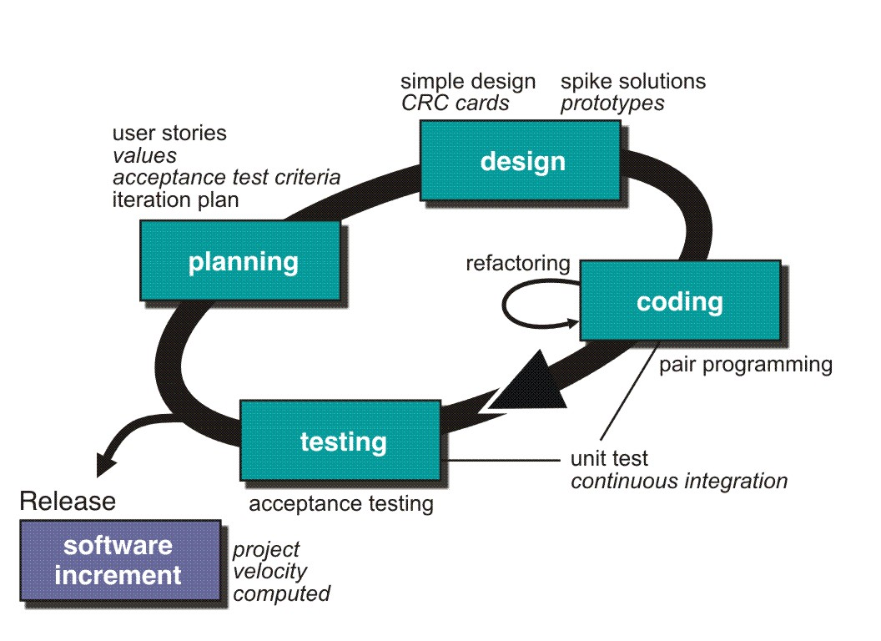
Extreme Programming (XP)

Slide 11
XP - Planning
Begins with the creation of a set of stories (also called user stories)
Each story is written by the customer and is placed on an index card
The customer assigns a value (i.e. a priority) to the story
Agile team assesses each story and assigns a cost
Stories are grouped to for a deliverable increment
A commitment is made on delivery date
After the first increment “project velocity” is used to help define subsequent delivery dates for other increments

Slide 12
XP - Design
Follows the KIS (keep it simple) principle
Encourage the use of CRC (class-responsibility-collaborator) cards
For difficult design problems, suggests the creation of “spike solutions”—a design prototype
Encourages “refactoring”—an iterative refinement of the internal program design
Design occurs both before and after coding commences

Slide 13
XP - Coding
Recommends the construction of a series of unit tests for each of the stories before coding commences
Encourages “pair programming”
Mechanism for real-time problem solving and real-time quality assurance
Keeps the developers focused on the problem at hand
Needs continuous integration with other portions (stories) of the s/w, which provides a “smoke testing” environment

Slide 14
XP - Testing
Unit tests should be implemented using a framework to make testing automated. This encourages a regression testing strategy.
Integration and validation testing can occur on a daily basis
Acceptance tests, also called customer tests, are specified by the customer and executed to assess customer visible functionality
Acceptance tests are derived from user stories

Slide 15
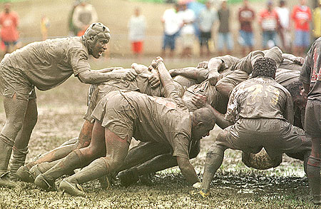
Scrum

Slide 16
Scrum
A software development method Originally proposed by Schwaber and Beedle (an activity occurs during a rugby match) in early 1990.
Scrum—distinguishing features
Development work is partitioned into “packets”
Testing and documentation are on-going as the product is constructed
Work units occurs in “sprints” and is derived from a “backlog” of existing changing prioritized requirements
Changes are not introduced in sprints (short term but stable) but in backlog.
Meetings are very short (15 minutes daily) and sometimes conducted without chairs ( what did you do since last meeting? What obstacles are you encountering? What do you plan to accomplish by next meeting?)
“demos” are delivered to the customer with the time-box allocated. May not contain all functionalities. So customers can evaluate and give feedbacks.

Slide 17
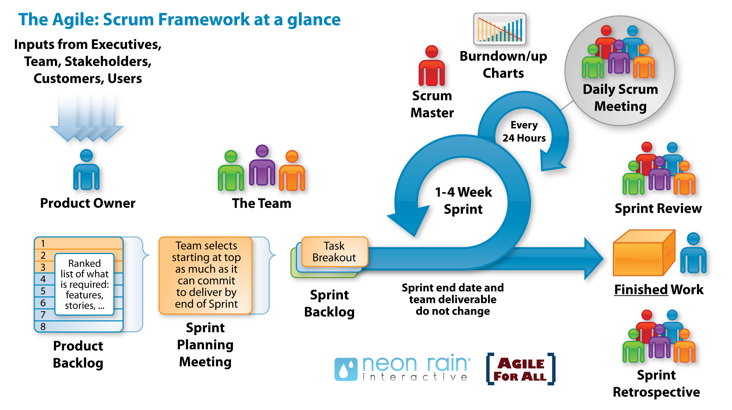
Scrum

Slide 18
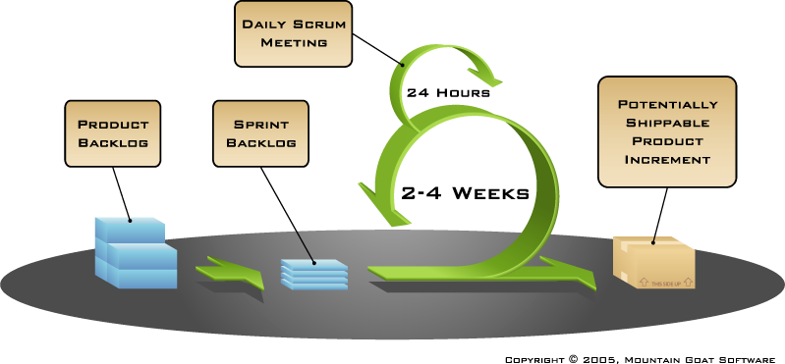
How Scrum Works?

Slide 19
Sprints
Scrum projects make progress in a series of “sprints”
Analogous to XP iterations
Target duration is one month
+/- a week or two
But, a constant duration leads to a better rhythm
Product is designed, coded, and tested during the sprint

Slide 20
Scrum's core values
Commitment. Because we have great control over our own destiny, we become more committed to success.
Focus. Because we focus on only a few things at a time, we work well together and produce excellent work. We deliver valuable items sooner.
Openness. As we work together, we practice expressing how we're doing and what's in our way. We learn that it is good to express concerns so that they can be addressed.
Respect. As we work together, sharing successes and failures, we come to respect each other and to help each other become worthy of respect.
Courage. Because we are not alone, we feel supported and have more resources at our disposal. This gives us the courage to undertake greater challenges

Slide 21
Other Agile Processes
Adaptive Software Development (ASD)
Dynamic Systems Development Method (DSDM)
Crystal
Feature Driven Development
Agile Modeling (AM)

